Slide 1
Stephanie Godsey
Cofsp recipient
University of Cincinnati
Senior civil engineering student
School of Creative and Performing Arts
9th and 10th grade geometry and honors geometry

Slide 2
Academic standards
Determining mathematic equations
Computing mathematic equations
Problem Solving
Finding areas of different geometric shapes
Scaling

Slide 3
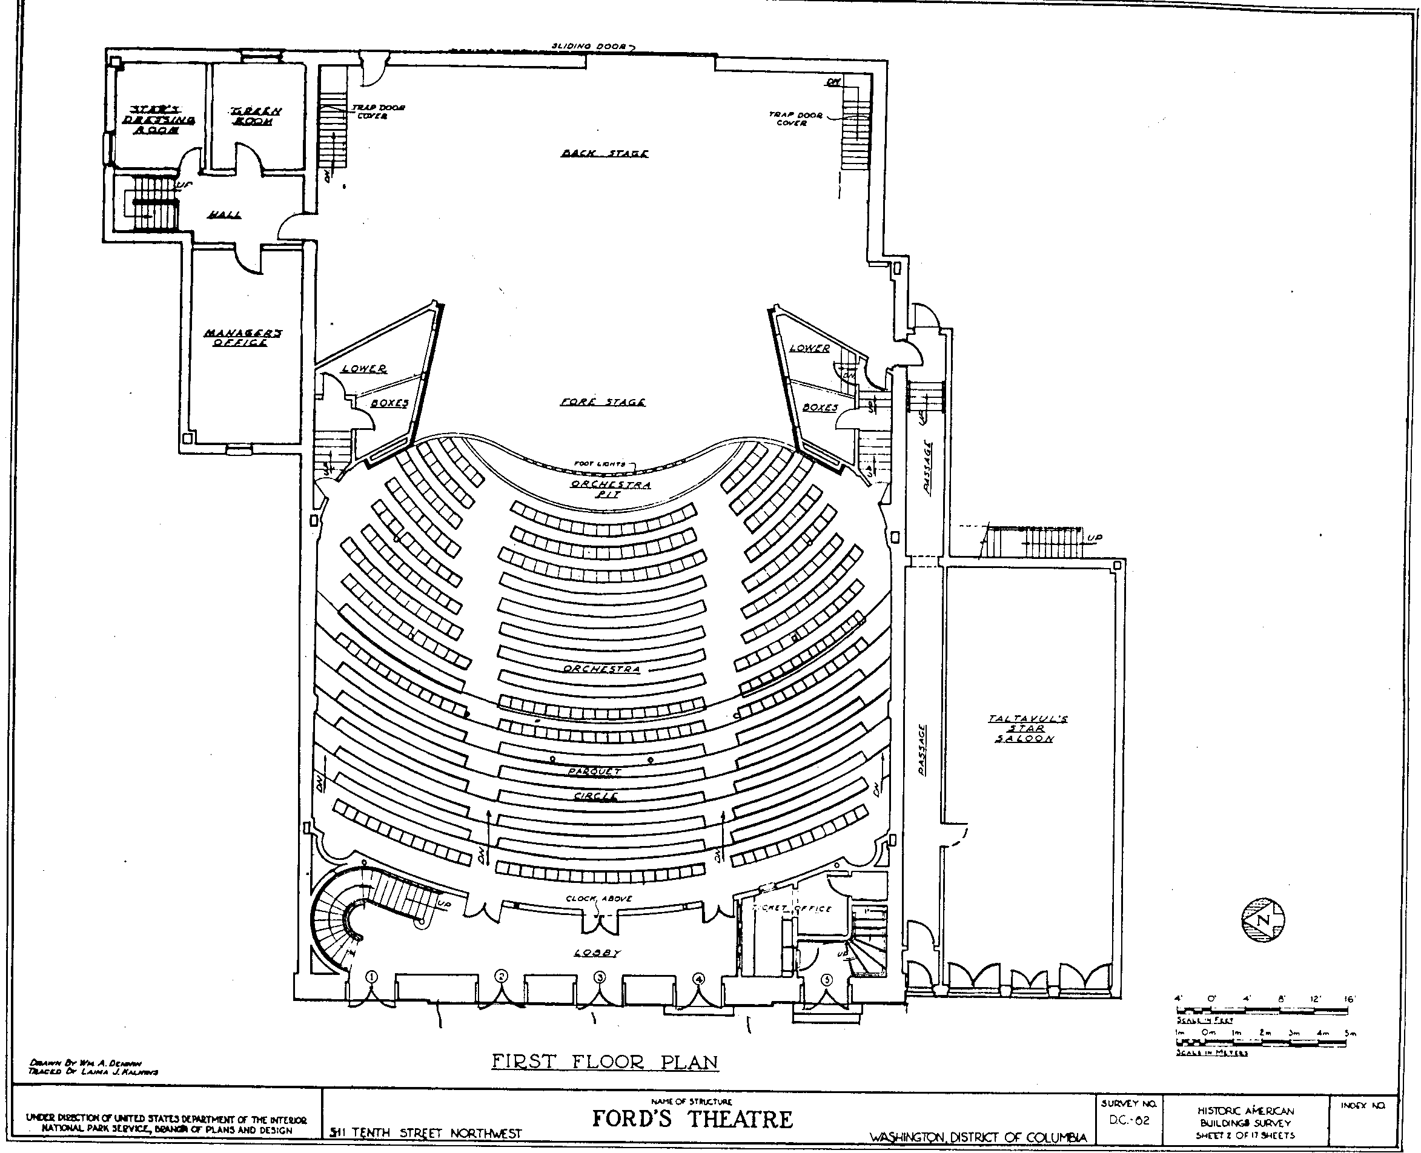
Activity: Cost Estimate
Learning Objectives: Find shape areas and convert areas to realistic cost
Guiding Question: How do you estimate the cost of constructing a performing arts theater?

Slide 4
acs
This activity forced students to examine the practicality of designing a floor plan of a performing arts theater.
The students had to make corrections if their theater was not realistically a functional floor plan.
The computations performed in order to find the cost of construction were actual computations a civil engineer would do in reality.

Slide 5
Proof of student growth

Slide 6
reflection
Positive
Negative
Assessment proves they took in information
They all participated
Seemed to enjoy the hands on activity
Realization of the cost of construction was surprising
Scaling issue
Unrealistic room dimensions
Improve explanation of civil engineering

